Slide 1
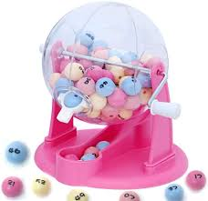
Survey Data analysis week 3 Simple Random Sampling
© Peter Lugtig

Slide 2
The big picture
Inference
use a small dataset to say something about the world
Design based:
probability based sampling and inference
Estimate and correct for each TSE source
Weeks 3-~8
Model-based
Big data, any data?
Model all the data errors, but how?
Week 9 -~14

Slide 3

Take home exercise of week 2
Deck of 52 cards
Spades, diamonds, clubs, hearts
Each suit: 13 cards
How many cards of Spades?
When sample of size 10/40
When drawing with/without replacement
Your results

Slide 4
Simple Random Sampling
Every element on the sampling frame has an equal, non-zero probability of being selected into sample
Element: individuals/households/companies
Population: collection of elements
Why/when use a SRS?

Slide 5
Simple random sampling: when?
There is a sampling frame consisting of population elements
Bonus Q: what to do if we have no frame?
No need for clustering
Depends on mode
Web/mail vs. face-to-face/telephone
No need for stratification
Little is known about people on sampling frame
Known characteristics do not correlate with dependent variables

Slide 6
The sampling distribution
See file “simulation_cards_srs.R”
Idea:
Every sample will have a slightly different estimate
What matters is whether [the method] gives you a consistent estimate of the population in the long run
Simple Random Sampling is an asymptoticially unbiased estimator
We can repeat the experiment 10.000 times!

Slide 7
Sampling with/without replacement
When does it not matter?
Selecting 1 out of 52 cards

Slide 8
Sampling without replacement (SRSWOR)
When does with/without not matter?
Selecting 1 out of 52 cards
What happens when we select 2 cards WOR
Card 1:
13/52 chance for Spades
Card 2:
75% chance for 13/51
25% chance for 12/51
Expected value for 2 cards:
0.25 + (.75*13/51+.25*12/51)=
0.25 + .1912 + .0588 = .50 Spades

Slide 9
Sampling with replacement (SRSWR)
When does it not matter?
Selecting 1 out of 52 cards
What happens when we select 2 cards WR
Card 1:
13/52 chance for Spades
Card 2:
13/52
Expected value for 2 cards:
0.25 + 0.25 = 0.50
SRS(WR) and SRSWOR are both unbiased estimators of population mean
Also of mode/median (the beauty of the central limit theorem)
We assume no other errors (coverage, nonresponse)

Slide 10
what’s the fuss – variance of estimator
Extreme case: select 52 of 52 cards
Expected value: 13 Spades in both
Variance SRSWOR estimator: 0
Repeating it a 1000 times -> always 13 spades
This method needs correction -> without it is biased
Variance SRS(WR) estimator: 9.48
Repeating it a 1000 times -> variation
Difference in variance is larger when a larger proportion of population is sampled

Slide 11
Estimators
If we repeat a study n times (say 10000 times), we can investigate:
Bias: is the mean/variance/etc. correctly estimated in the long run?
Do we get p=.25 for spades on average?
Variance of estimator (precision)
How much variation is there in the mean?
In reality we take just 1 sample!
Consistent: does it work across all situations?
Different kinds of data
Mean Square Error = bias² + variance
A good estimator often minimizes MSE

Slide 12

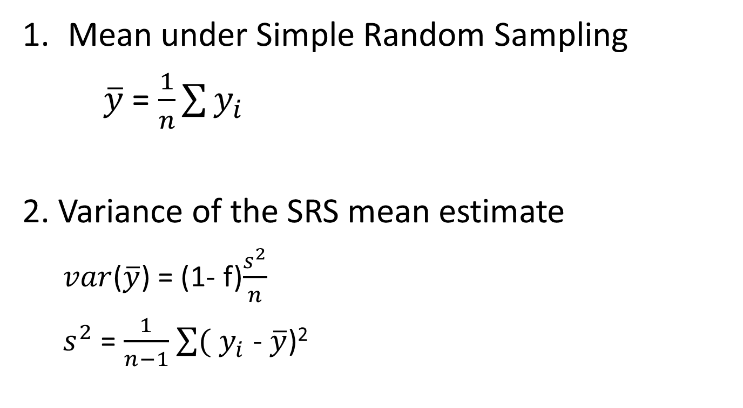
Computation SRSWOR (without)
Mean under Simple Random Sampling
$\overline{y}$ = $\frac{1}{n}\sum{y_{i}}$
2. Variance of the SRS mean estimate
$var$($\overline{y}$) = (1- f)$\frac{s^{2}}{n}$
$s^{2}$ = $\frac{1}{n−1}$ $\sum{(}$ $y_{i}$ - $\overline{y}$)²
Correction 1: fpc (1-f)
Correction 2: Divide by n-1
n = sample size, $s^{2}$= variance in sample

Slide 13
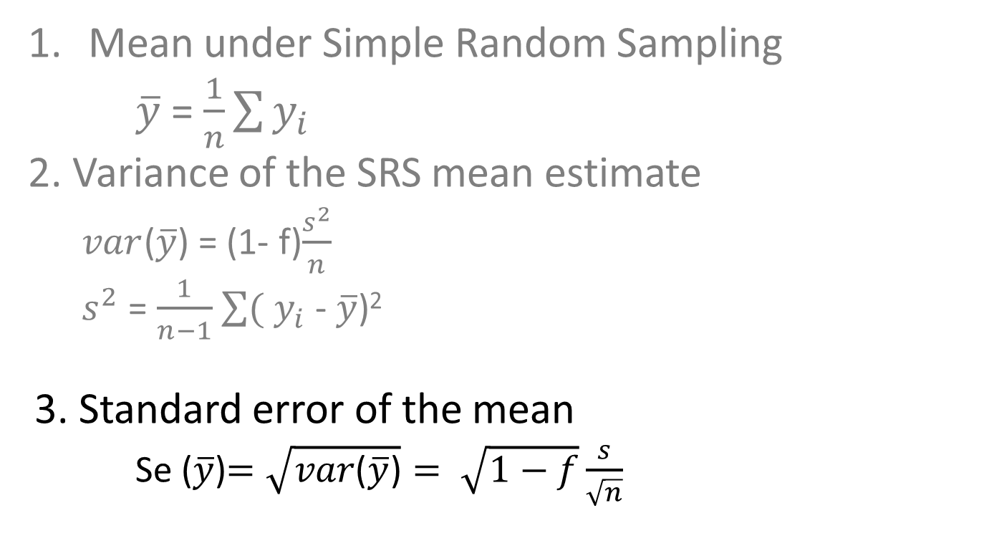
How do we compute se in SRSWOR ?
Mean under Simple Random Sampling
$\overline{y}$ = $\frac{1}{n}\sum{y_{i}}$
2. Variance of the SRS mean estimate
$var$($\overline{y}$) = (1- f)$\frac{s^{2}}{n}$
$s^{2}$ = $\frac{1}{n−1}$ $\sum{(}$ $y_{i}$ - $\overline{y}$)²
3. Standard error of the mean
Se ($\overline{y}$)$=\sqrt{var\text{(}\overline{y}\text{)}}= \sqrt{1−f}\frac{s}{\sqrt{n}}$
Se = standard error, n = sample size, s=standard deviation in sample

Slide 14
Intermezzo 1: Fpc in practice
Fpc = (1-f) = (1-n/N) or (N-n)/N
In SRSWOR, correction
fpc approaches 1 when n/N small
when sample of 1.000 people in the Netherlands is drawn:
Fpc = 1 – 1.000/17.000.000 = 1 – 0,00058 = 0,99942
When sampling fraction n/N < .05, ignore FPC
We assume a infinite population

Slide 15
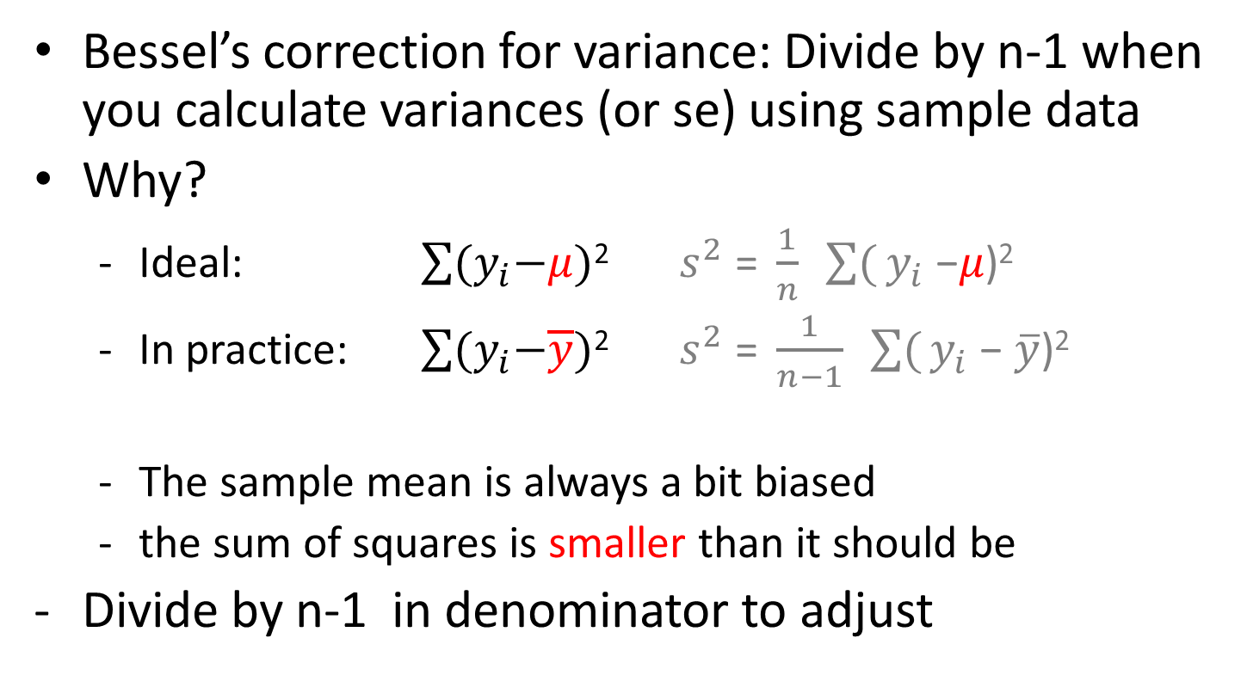

Intermezzo 2: (n-1) or n?
Bessel’s correction for variance: Divide by n-1 when you calculate variances (or se) using sample data
Why?
Ideal: $\sum{{(y}_{i}−μ)}$² $s^{2}\text{ = }\frac{1}{n} \sum{(}y_{i}\text{ −}μ\text{)}\text{2}$
In practice: $\sum{{(y}_{i}−\overline{y})}$² $s^{2}\text{ = }\frac{1}{n−1} \sum{(}y_{i}\text{ − }\overline{y}\text{)}\text{2}$
The sample mean is always a bit biased
the sum of squares is smaller than it should be
Divide by n-1 in denominator to adjust
$$μ=population mean$$

Slide 16
Why smaller?
Sum of squares is too small when using a sample
Why? Here is what we would like
$\sum{(y_{i}−\overline{y})}$+ ($\overline{y}$ - $μ$)²
Divide by n-1 in denominator to adjust
dividing by n-1 works for variance, but biased for s! (sqrt(s²))
When you would resample many times
Not the smallest MSE with many types of data
often sqrt(1.5) used instead of n-1 in larger samples
Just remember: use n-1 for variance estimate of mean
Want to know more? See “bessels correction.r”

Slide 17

A real example
I would like to do a survey among all students at Utrecht University
Population = 20.000
RQ: Interested in differences in grades and student happiness between programmes
approx. 49 BA programmes and 150 MA programmes
Limited budget (cannot do census) for about n=1000
5 minutes: how do we
do this?

Slide 18
Example: possible solution
Cheap: e-mail
Sample all students? A census
Can do complicated stratification to ensure enough students from every programme
200 + programmes…
Simple random sampling (SRS)
Risk of small n for some programmes.
Let’s work out how SRS works
And talk about sample size

Slide 19
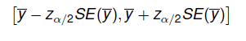
Why is standard error useful?
Gives indication of both
Uncertainty due to sampling error
Uncertainty in estimation (e.g. ML estimation)
Used to construct confidence Interval:

Slide 20
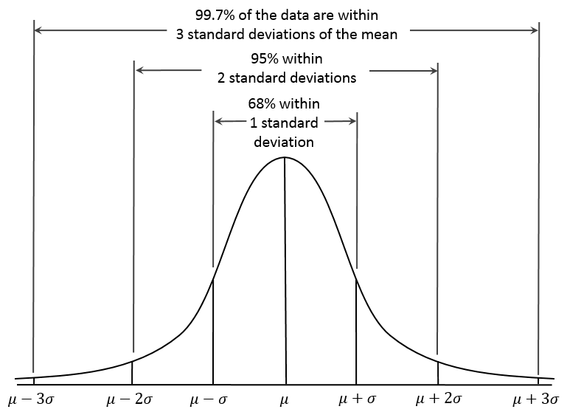
s.e. and confidence intervals
With alpha=.05
Two-sided test
Z-value for alpha=.05: 1.96
Confidence interval
[-1.96*se, +1.96*se]

Slide 21
Margin of error
With alpha=.05
Two-sided test
Margin of error
(radius of CI)
1.96 * s.e.

Slide 22
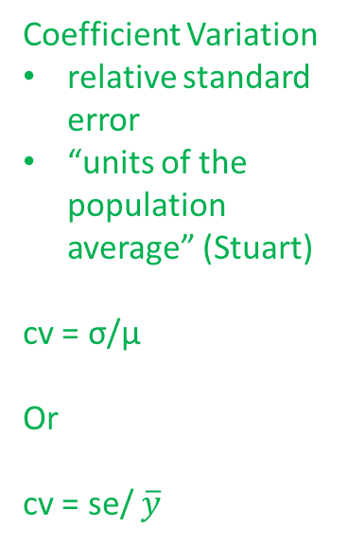
Coefficient of variation
With alpha=.05
Two-sided test
Coefficient Variation
relative standard error
“units of the population average” (Stuart)
cv = σ/μ
Or
cv = se/ $\overline{y}$

Slide 23
Short exercise
What is mean grade of students at Utrecht University (1-10-scale)
Population = 20.000 students
Best guesses for means and Variance?
Mean: 7.0
variance: 4
Take a sample of n=200 (don’t worry about fpc (as n/N = .01))
What is the standard error?
What is the margin of error?
What is coefficient of variation?

Slide 24

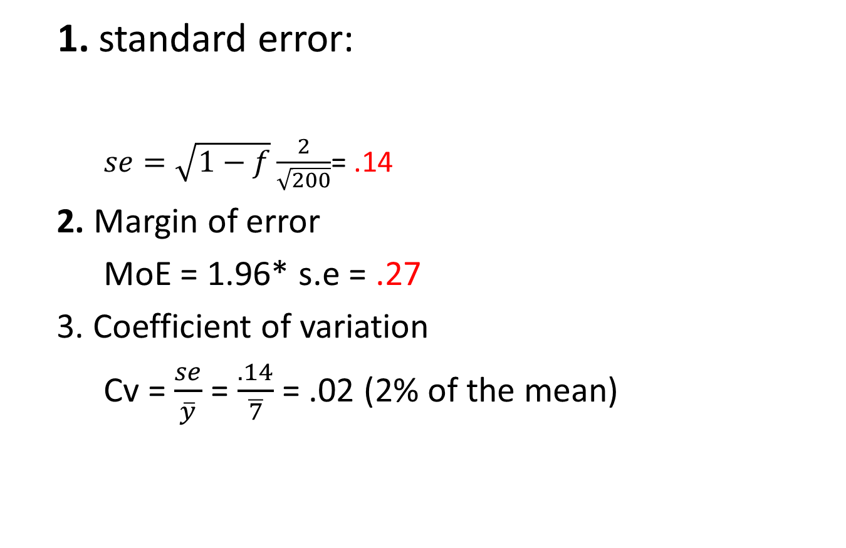
Solution:
1. standard error:
$se=\sqrt{1−f}\frac{2}{\sqrt{200}}$= .14
2. Margin of error
MoE = 1.96* s.e = .27
3. Coefficient of variation
Cv = $\frac{se}{\overline{y}}$ = $\frac{.14}{\overline{7}}$ = .02 (2% of the mean)
$$se= \sqrt{1−f}\frac{s}{\sqrt{n}}$$

Slide 25
What if we need to be more precise?
How can confidence interval change?
Variance in sample/population
Required precision of Confidence Interval
Alpha
Size of sample (n)
What if:
n=400, alpha = .05

Slide 26
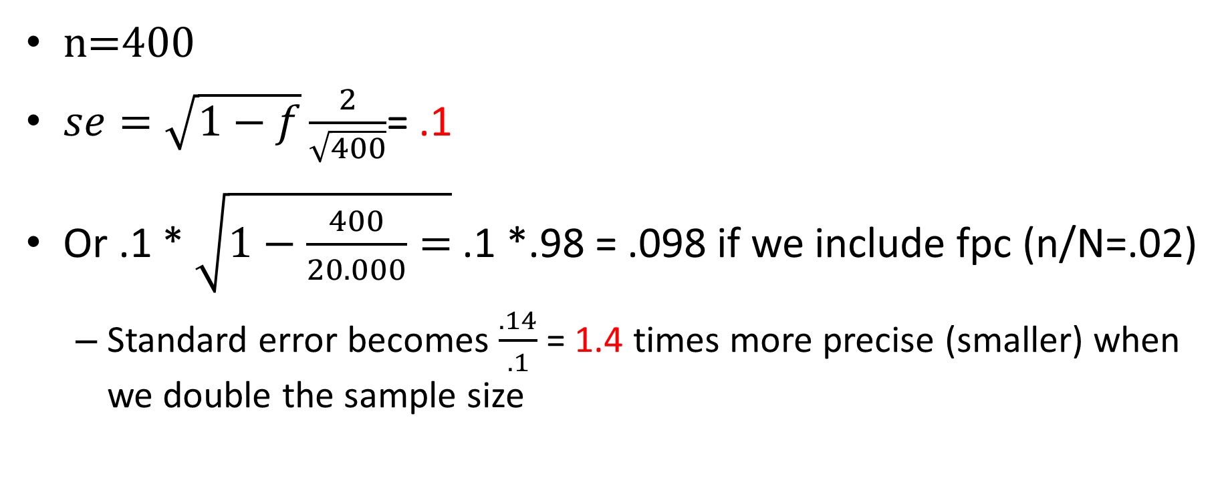
Solution:
n=400
$se=\sqrt{1−f}\frac{2}{\sqrt{400}}$= .1
Or .1 * $\sqrt{1−\frac{400}{20.000}=}$ .1 *.98 = .098 if we include fpc (n/N=.02)
Standard error becomes $\frac{.14}{.1}$ = 1.4 times more precise (smaller) when we double the sample size

Slide 27
MoE and sample size

Slide 28
Break

Slide 29
What if we need to be more precise?
How can confidence interval change?
Variance in sample/population
Required precision of Confidence Interval
Alpha
Size of sample (n)
What if:
n=400, alpha = .005 (multiple testing issue from MSSBBS02)

Slide 30
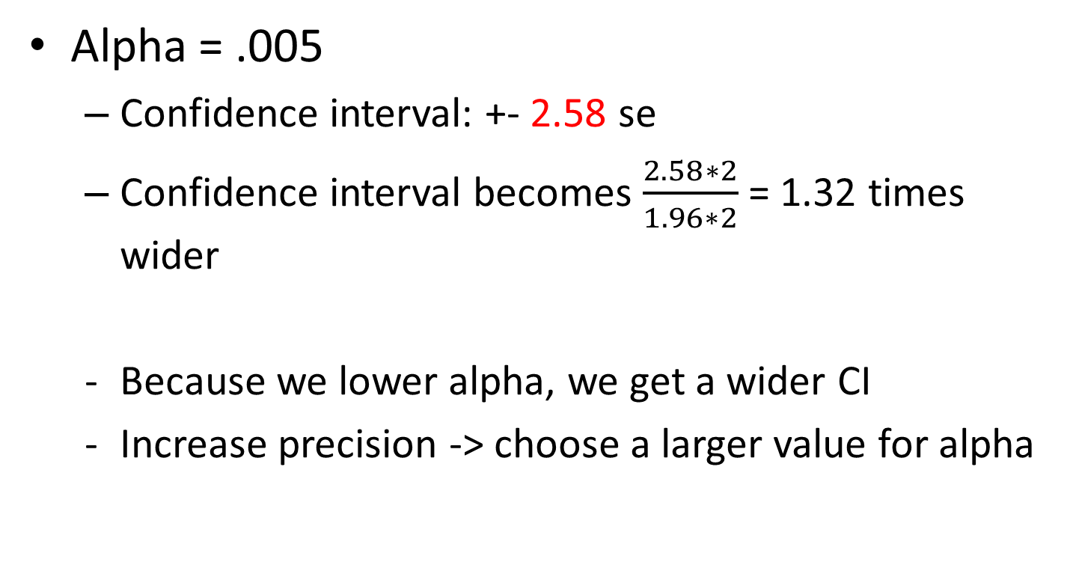
Solution
Alpha = .005
Confidence interval: +- 2.58 se
Confidence interval becomes $\frac{2.58∗2}{1.96∗2}$ = 1.32 times wider
Because we lower alpha, we get a wider CI
Increase precision -> choose a larger value for alpha

Slide 31
How large should my sample be?
#1. question in statistical consultation
Depends on:
Statistic of interest (here: mean)
Variance in sample/population
Required precision of Confidence Interval
Alpha, standard error
Size of sample/population (n/N)
Often, we want to test for size of difference between groups (see take home exercise) and therefore Power also plays a role

Slide 32
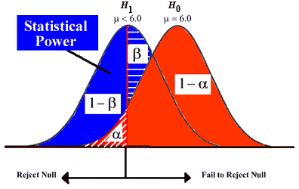
α? Power (β)?
Type I error (α) is to reject H0 while H0 is true
Type II error (β) is to accept H0 while H1 is true

Slide 33
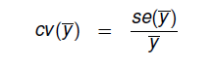
How large should my sample be?
α =.05
Standard error?
Estimate relative error instead
Coefficient of variation

Slide 34
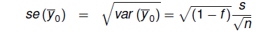
Class exercise
What is mean grade of students at Utrecht University (1-10-scale) under SRS?
Population = 20.000 students
Best guesses for means and Variance?
Mean: 7.0
variance: 4
I want to be precise: s.e. restricted to 2% (cv=.02)
Implies CI of [-1.96 *2 ; 1.96*2] = 7.84%, and
Margin of error [1.96*2] = 3.92% of mean
Alpha = .05
How large should sample be?
1.
2.

Slide 35
Solution:
1. standard error:
.02 = x / 7 = .14/7
2. Compute n under SRSWOR:
.14 = sqrt(1-f)* (2/sqrt(n))
2/.14 = sqrt(n)/sqrt(1-f) = 14.286² /sqrt(1-f).
n=204.08 (or 205)
We may ignore fpc because sampling fraction <5%
Or: f = 1-(205/20.000) = 1-.01 = .99
2/.14/(sqrt(.99) = sqrt(n) = 14.43² = 206.14 (or 207)

Slide 36
Estimator
Equal selection probabilities (SRS):
Unbiased estimator of mean, variance in population
Can use sample size to manipulate precision
Also of regression (OLS), other estimates
So, with an SRS, you can use the data as is
When there are no coverage and nonresponse errors
Unequal selection probabilities
You can’t use the data as is…

Slide 37
Why unequal probabilities?
Because you want to make your design cheaper or more efficient
Stratification and clustering
Next time
Because there are issues with your list
Why?

Slide 38
Coverage and sampling issues in SRS
Your list may have double entries
E.g. students enrolled in multiple programmes
Sometimes you don’t know in advance
E.g. multiple telephone numbers in RDD designs
You have a list of clusters, but want individuals
Addresses -> individuals
How many people live at this address?
Problem -> take unequal selection probabilities into account

Slide 39
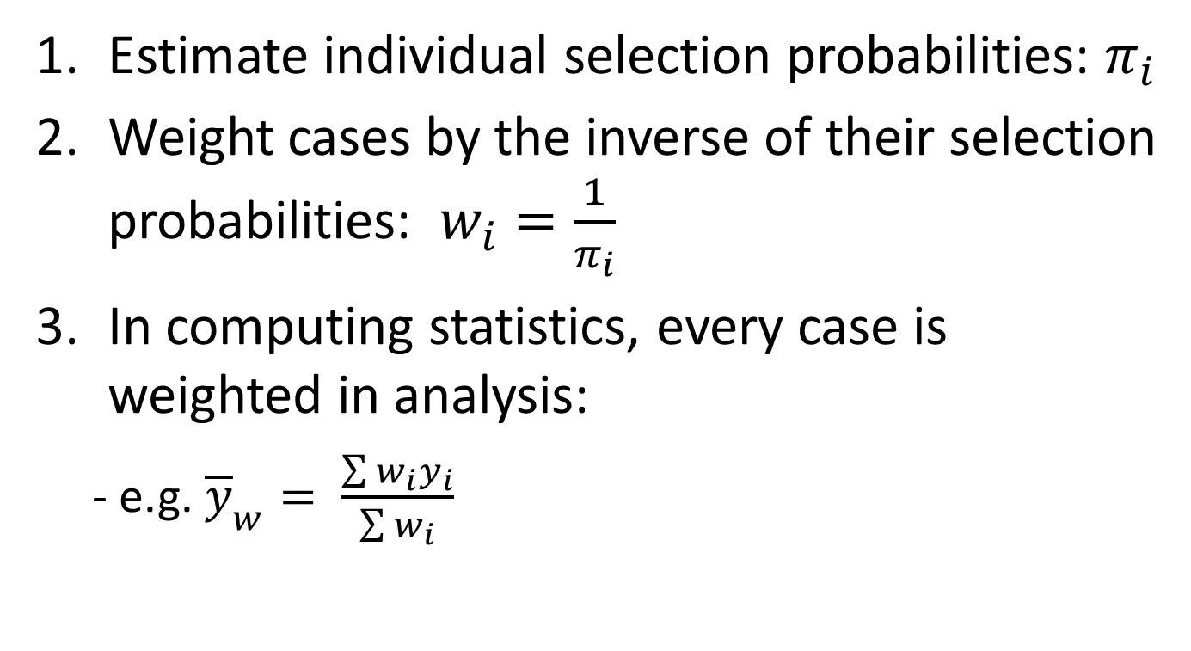
What to do:
Estimate individual selection probabilities: $π_{i}$
Weight cases by the inverse of their selection probabilities: $w_{i}=\frac{1}{π_{i}}$
In computing statistics, every case is weighted in analysis:
- e.g. ${\overline{y}}_{w}= \frac{\sum{w_{i}y_{i}}}{\sum{w_{i}}}$

Slide 40
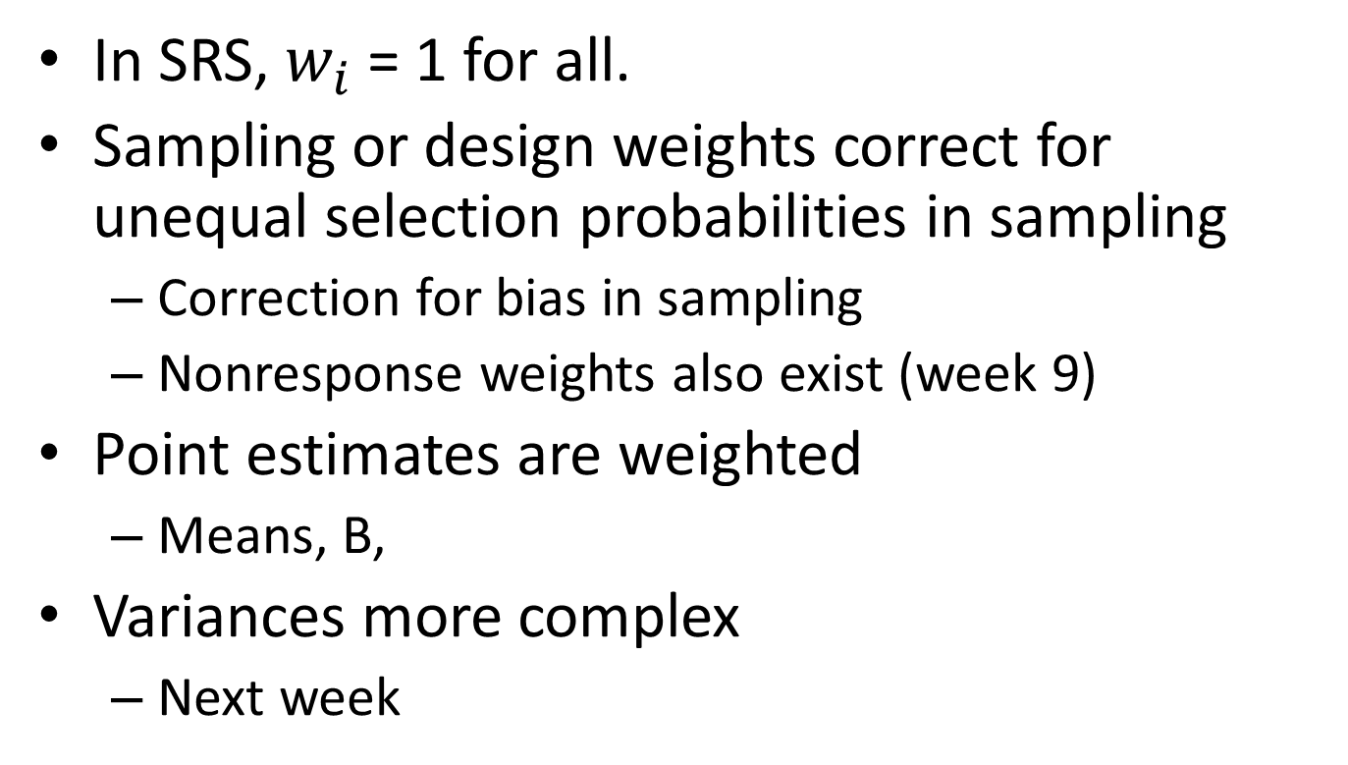
Weights
In SRS, $w_{i}$ = 1 for all.
Sampling or design weights correct for unequal selection probabilities in sampling
Correction for bias in sampling
Nonresponse weights also exist (week 9)
Point estimates are weighted
Means, B,
Variances more complex
Next week

Slide 41
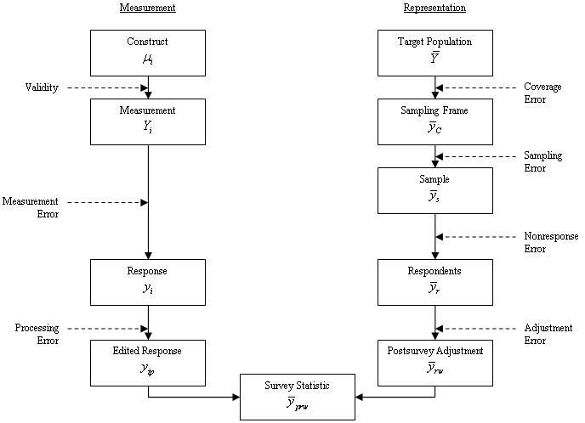
Weights

Slide 42
Next week
Take home exercise week 3
Draw SRS samples (once more)
Work with Svydesign in R
Work with design weights
Compute sample sizes (power analysis)
Next time:
We will discuss sampling designs with explicit unequal selection probabilities (stratification and clustering)
Read Stuart

